Slide 1
RX BIST
Ovidiu Ivanica
Rami Hanganu
SEPTEMBER 2022

Slide 2
RX BIST Signal FLOW
ChirpPLL
TE
LOI (x4)
40GHz
40GHz
16bits samples
RF BIST
RX
ADC
PDC
PACKER
WDMA
80GHz
40MHz
M7
DTCM

Slide 3
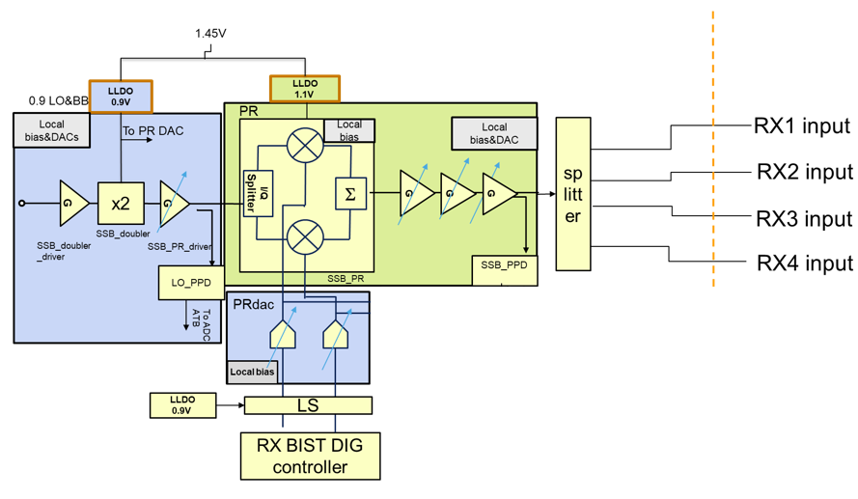
RX BIST IP Settings
Programming RX BIST IP to inject a signal into the RX IP requires:
Enabling the RX BIST function
Enabling the RXBIST IP
Enabling the 320MHz clock from MCGEN
Ignore TE triggering (triggerSource – SW)
Programming of the Baseband signal:
Double continuous wave output
Frequencies for two tones
Amplitude for two tones
Phases for two tones
Calibrated

Slide 4
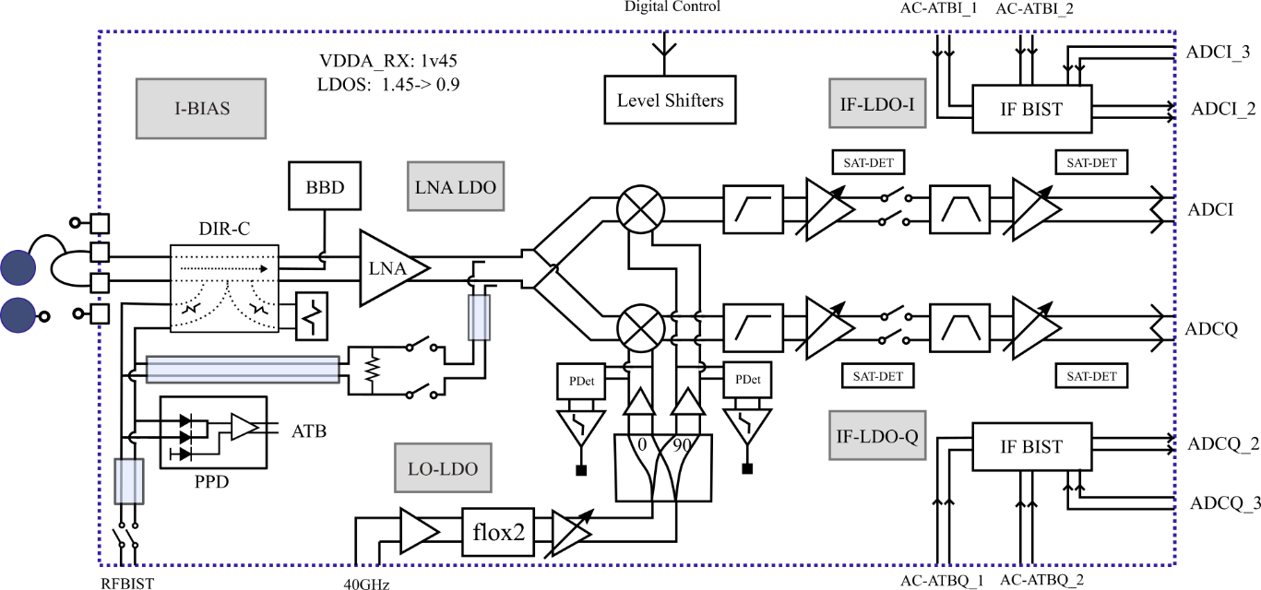
RX IP Settings
RX path presumed to be configured in Mode 0 (normal operation mode)
RX set in continuous wave mode (TE API)
BIST signal injection can be to figured in 2 modes:
Pre LNA (LNA test)
SelOp switch Open
After LNA (MIXER test)
SelOp switch Closed
Other switches:
SellP = Closed
VGA = Open
PPD = Open
Buffer = Open
BIST signal
This should already be calibrated

Slide 5
Top design level

Slide 6
STEPS (rfeswBist.c rfeswBist_RXBIST_INTERNAL.c )
Perform RX BIST test
Perform Zero Hour Reference Test
Save active profile & packer config
Enable BIST IP
Config TE (chirp sequence + profile 8)
Configure RX BIST tones
Configure WDMA output & buffers
Load profile 8
Select between pre-lna and after lna (mixer) signal injection
Trigger TE chirp sequence start
Perform DTF on IF signal
Check phase and amplitude against set thresholds and report errors
Load customer profile, revert packer config
Disable CW mode (BIST and RX)
Disable BIST module
Set / Get Zero Hour data
Init RX BIST
Perform RX BIST test
Return zero hour data
RX BIST Setup
Set Sampling Frequency
Set signal path
Set Sample Number
Data acquisition
Set RX BIST tones
Post processing
Load Zero Hour Data via Config
Set RX BIST thresholds
Phase & Amplitude checks
Set RX BIST test type (injection point )
Revert setup

Slide 7
Structures and ENUM types to be added (rfe_types.h & RFESWBIST.h)
/**
* This enumerated type defines the RX BIST test type.
*/
typedef enum
{
/** Perform RX BIST with the signal injection before the RX LNA. */
rfe_rxBist_lnaTest_e,
/** Perform RX BIST with the signal injection before the mixer(post RX LNA). */
rfe_rxBist_mixerTest_e
} rfe_rxBistTestType_t;
/**
* \struct
* \brief Structure to hold the RX BIST tresholds / pass criteria
*
* \details Structure to hold phase and amplitude tresholds / pass criteria for RX BIST test
*/
typedef struct
{
/** Phase treshold in degrees */
float phaseTreshold;
/** Gain treshold in dB */
float gainTreshold;
} rfeSwBist_rxBistTresholds_t;

Slide 8
Structures and ENUM types to be added (RFESWBIST.h)
/**
* \struct
* \brief Structure to hold two-tone values (measurement or target)
*
* \details Structure to hold two-tone values (measurement or target)
*/
typedef struct
{
/** Tone 1 voltage in mV */
float v1;
/** Tone 2 voltage in mV */
float v2;
/** Tone 1 frequency in Hz */
uint32_t f1;
/** Tone 2 frequency in Hz */
uint32_t f2;
/** Tone 1 phase in deg */
float ph1;
/** Tone 1 phase in deg */
float ph2;
} rfeSwBist_rxTwoToneLevels_t;
/**
* This struct contains zero hour reference data for rxBist returned by rfeSwBist_getBistZeroHourReferenceData.
*/
typedef struct
{
uint32_t rxFrequencyForBist;
uint16_t rxPhaseDiff[RFE_RX_BIST_COMBINATIONS];
uint16_t rxGainDiff[RFE_RX_BIST_COMBINATIONS];
bool injectTestToneBeforeLna;
}rfeSwBist_rxRefData_t;

Slide 9
DEFINES to be added (RFESWBIST.h)
#define RFE_RXBIST_AMPLITUDE_DIFF_MIN -40.0f // db
#define RFE_RXBIST_AMPLITUDE_DIFF_MAX +40.0f // db
#define RFE_RXBIST_PHASE_DIFF_MIN -180.0f// degrees
#define RFE_RXBIST_PHASE_DIFF_MAX 180.0f// degrees
#define RFE_RXBIST_SAMPLE_NO_MIN128U// samples
#define RFE_RXBIST_SAMPLE_NO_MAX4096U// samples
#define RFE_RXBIST_TONE_FREQ_MIN1000000ul// 1MHz

Slide 10
Performing RX BIST

Slide 11
Functions to be coded (Top level)
/**
* \brief This function performs the RX BIST.
*
* \param [in] rxBistTestType - RX BIST Test Type / Signal injection point:
* BIST Tone injection point options are pre LNA or post LNA (before MIXER)
*
* \param [in] zeroDayMeasurement - Boolean flag to tell if the RX BIST performs a zero-day
* measurement or if the RX BIST performs a normal test, comparing the measurement with
* the zero-day measurement data
*
* \param [in,out] RFE_ERROR_FUNCTION_PARAMETER - Error handling parameter:
* On success #RFE_ERROR_IS_NO_ERROR is true,
* On failure #RFE_ERROR_IS_ERROR is true
*/
void rfeSwBist_rxBist(
rfe_rxBistTestType_t rxBistTestType,
bool zeroDayMeasurement,
RFE_ERROR_FUNCTION_PARAMETER
);
RX BIST Setup
Set signal path
Data acquisition
Post processing
Phase & Amplitude checks
Revert setup

Slide 12
RX BIST Setup

Slide 13
Functions to be coded (rfeswbist_rxbist_internal.c)
/**
* \brief This function performs the RX built-in-self-test setup.
*
* \param [in,out] backupActiveProfile - Pointer to buffered active profile used to
* revert the active profile after the RX BIST has finished
*
* \param [in,out] RFE_ERROR_FUNCTION_PARAMETER - Error handling parameter:
* On success #RFE_ERROR_IS_NO_ERROR is true,
* On failure #RFE_ERROR_IS_ERROR is true
*/
void rfeSwBist_rxBistSetup(
rfeHw_profileIndex_t *backupActiveProfile,
RFE_ERROR_FUNCTION_PARAMETER
);
Steps for setting up the RX BIST:
Save active profile for restoring at the end of the test
Configure TE (profile 8 timings)
Configure BIST (tones and triggering)
Configure Packer (save current config and set data output for WDMA)
Configure WDMA
Load profile 8 (bist)

Slide 14
RX BIST Signal Path

Slide 15
Functions to be coded (rfeswbist_rxbist_internal.c)
/**
* \brief This function performs the RX built-in-self-test setup.
*
* \param [in] rxBistTestType - RX BIST Test Type / Signal injection point:
* BIST Tone injection point options are pre LNA or post LNA (before MIXER)
*
* \param [in,out] RFE_ERROR_FUNCTION_PARAMETER - Error handling parameter:
* On success #RFE_ERROR_IS_NO_ERROR is true,
* On failure #RFE_ERROR_IS_ERROR is true
*
*/
void rfeSwBist_rxBistSignalPathSelect(
rfe_rxBistTestType_t rxBistTestType,
RFE_ERROR_FUNCTION_PARAMETER
);
Steps for choosing BIST signal injection path:
Enable LNA
Configure switches (circled in red)
Pre LNA (LNA test) - SelOp switch Open
After LNA (MIXER test) - SelOp switch Closed
Other switches:
SellP = Closed
VGA = Open
PPD = Open
Buffer = Open

Slide 16
RX BIST Acquisition

Slide 17
Functions to be coded (rfeswbist_rxbist_internal.c)
/**
* \brief This function performs the RX built-in-self-test setup.
*
* \param [in,out] RFE_ERROR_FUNCTION_PARAMETER - Error handling parameter:
* On success #RFE_ERROR_IS_NO_ERROR is true,
* On failure #RFE_ERROR_IS_ERROR is true
*/
void rfeSwBist_rxBistAcquisition(
RFE_ERROR_FUNCTION_PARAMETER
);
Steps for RX BIST chirp acquisition:
Stard WDMA streams
Wait 40 cycles
Send chirp start trigger to TE
Wait 29us + RFE_SW_RXBIST_DC_POWERON_DELAY
Stop WDMA streams

Slide 18
RX BIST Post Processing

Slide 19
Functions to be coded (rfeswbist_rxbist_internal.c)
/**
* \brief This function performs the RX BIST signal post-processing (DFTs).
*
* \param [in,out] RFE_ERROR_FUNCTION_PARAMETER - Error handling parameter:
* On success #RFE_ERROR_IS_NO_ERROR is true,
* On failure #RFE_ERROR_IS_ERROR is true
*
*/
void rfeSwBist_rxBistPostProcessing(
RFE_ERROR_FUNCTION_PARAMETER
);
The post processing performed on the RX BIST signal consists of DTFs on the two test tones.
The output of the post-processing consists of phase (in radians) and amplitude (mV) data for the 4 RX channels

Slide 20
RX BIST check flow structure

Slide 21
rfeSwBist_rxBistSetup()
rfeSwBist_rxBistSignalPathSelect()
rfeSwBist_rxBistAcquisition()
RxBist()
rfeSwBist_rxBistPostProcessing()
rfeSwBist_rxBistPostProcessing()
rfeSwBist_normalizeAngleToPi()
rfeSwBist_rfeSwBist_rxBistPhaseCheck()
rfeSwBist_rxBistCheckAndThrowError()
rfeSwBist_rfeSwBist_rxBistPhaseCheck()
rfeSwBist_rxBistAmplitudeCheck()
rfeSwBist_rxBistAmplitudeCheck()
rfeDspMath_log10F()
rfeSwBist_rfeSwBist_rxBistRevertSetup()
rfeSwBist_rxBistCheckAndThrowError()
Phase PHASE and Gain diff analysis

Slide 22
RX BIST Phase checks

Slide 23
Functions to be coded (rfeswbist_rxbist_internal.c)
/**
* \brief This function performs the RX built-in-self-test setup.
*
* \param [in] zeroDayMeasurement - Boolean flag to tell if the RX BIST performs a zero-day
* measurement or if the RX BIST performs a normal test, comparing the measurement with
* the zero-day measurement data
*
* \param [in,out] RFE_ERROR_FUNCTION_PARAMETER - Error handling parameter:
* On success #RFE_ERROR_IS_NO_ERROR is true,
* On failure #RFE_ERROR_IS_ERROR is true
*/
void rfeSwBist_rxBistPhaseCheck(
bool zeroDayMeasurement,
rfeSwBist_rxBistGainPhaseDiff_t *zeroDayMeasurementBuff,
rfe_rxBistTestType_t rxBistTestType,
RFE_ERROR_FUNCTION_PARAMETER
);
The RX BIST phase check consists of the following list of steps performed for RX2, RX3 and RX4:
Convert the phase measurement of RXk, k=2 -> 4 from radians to degrees
Calculate the phase difference between RX1 and RXk, k=2 -> 4
If the zeroDayMeasurement flag is:
True: store the phase difference in the zero day measurement buffer to be returned through the API
False: compare the phase difference to the zero day measured difference for the same RX pair and report an error if greater than the phase difference treshold

Slide 24




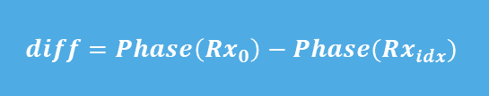












Phase diff analysis flow for one tone
$idx$ = 1
$idx$ < 4
$$true$$
$$diff=Phase\left(Rx_{0}\right)−Phase(Rx_{idx})$$
$phaseDiff$ = zeroDay($Rx_{0}Rx_{idx}$) - $diff$
$$false$$
diff = Phase(Rx_0) - Phase(Rx_idx)
$$done$$
Transform $diff$ to degrees
normalize $phaseDiff$ to $π$
Transform diff to degrees
Normalize $diff$ to $π$
zeroDayBuff[idx].pahaseDiff = $diff$
Normalize diff to π
$$ABS(phaseDiff)$$
$$phaseDiff > phaseTreshold$$
$$true$$
zeroDay == true
$$false$$
$$false$$
$$true$$
Report fusa fault

Slide 25
RX BIST Aplitude checks

Slide 26
Functions to be coded (rfeswbist_rxbist_internal.c)
/**
* \brief This function performs the RX built-in-self-test setup.
*
* \param [in]zeroDayMeasurement - Boolean flag to tell if the RX BIST performs a zero-day
* measurement or if the RX BIST performs a normal test, comparing the measurement with
* the zero-day measurement data
*
* \param [in,out] RFE_ERROR_FUNCTION_PARAMETER - Error handling parameter:
* On success #RFE_ERROR_IS_NO_ERROR is true,
* On failure #RFE_ERROR_IS_ERROR is true
*/
void rfeSwBist_rxBistAmplitudeCheck(
bool zeroDayMeasurement,
rfeSwBist_rxBistGainPhaseDiff_t *zeroDayMeasurementBuff,
rfe_rxBistTestType_t rxBistTestType,
RFE_ERROR_FUNCTION_PARAMETER
);
The RX BIST amplitude check consists of the following list of steps performed for RX2, RX3 and RX4:
Convert the amplitude measurement of RXk, k=2 -> 4 from voltage to dB: 20log (Vrx1/Vrxk)
Calculate the amplitude difference between RX1 and RXk, k=2 -> 4
If the zeroDayMeasurement flag is:
True: store the amplitude difference in the zero day measurement buffer to be returned through the API
False: compare the amplitude difference to the zero day measured difference for the same RX pair and report an error if greater than the amplitude difference threshold

Slide 27


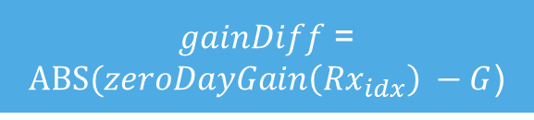


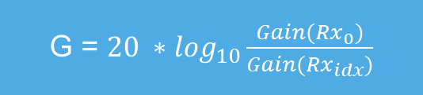




Phase diff analysis flow for one tone
$idx$ = 1
$idx$ < 4
$$true$$
$$false$$
$$done$$
G = $20 ∗\log_{10}\frac{Gain(Rx_{0})}{Gain(Rx_{idx})}$
$gainDiff$ = $ABS(zeroDayGain\left(Rx_{idx}\right) −G$)
zeroDayBuff[idx].gainDiff = G
$$true$$
zeroDay == true
$$false$$
$gainDiff$ > $gainTreshold$
$$false$$
$$true$$
Report fusa fault

Slide 28
RX BIST Setters/Getters

Slide 29
Functions to be coded (rfeswbist_rxbist_internal.c)
void rfeSwBist_setZeroDay(rfeSwBist_rxBistGainPhaseDiff_t input_data, RFE_ERROR_FUNCTION_PARAMETER);
void rfeSwBist_getZeroDay(rfeSwBist_rxBistGainPhaseDiff_t *output_data, RFE_ERROR_FUNCTION_PARAMETER);
void rfeSwBist_setSamplingFreq( rfe_effectiveSamplingFrequency_t newSamplingFreq, RFE_ERROR_FUNCTION_PARAMETER);
void rfeSwBist_setSampleNumber( uint32_t newSampleNumber, RFE_ERROR_FUNCTION_PARAMETER);
void rfeSwBist_setRxBistThresholds(float phaseThreshold, float gainTreshold, RFE_ERROR_FUNCTION_PARAMETER);
void rfeSwBist_setRxBistTones( rfeSwBist_rxTwoToneLevels_t newRxBistTones, RFE_ERROR_FUNCTION_PARAMETER);
void rfeSwBist_setRxBistTestType( rfe_rxBistTestType_t newRxBistTestType, RFE_ERROR_FUNCTION_PARAMETER );

